Slide 1
PROJECT TITLE : Encryption and Decryption between users in Morse using a Flashlight
PROJECT DOMAIN :
Internet Of Things

Slide 2
ABSTRACT
Morse code is the most basic emergency communication method. It expresses alphabet and numbers by using the combinations of dots and dashes.
Morse code is a method of encoding text characters based on signal duration. Alphabets and numbers are represented as dots and dashes

Slide 3
Table of contents
Introduction
Existing Method
Proposed method with Architecture
Methodology
Implementation
conclusion

Slide 4
Introduction
It is one of the methods used in telecommunication to encode text characters as standardized sequences of two different signal durations, called dots and dashes, or dits and dahs.
Morse code is named after Samuel Morse, one of the inventors of the telegraph.
Morse code:

Slide 5
Existing method
An original solution to the problem that caretakers have to learn to decode has been an electronic typewriter with the codes written on the keys.
Morse code can also be translated by computer and used in a speaking communication aid.

Slide 6
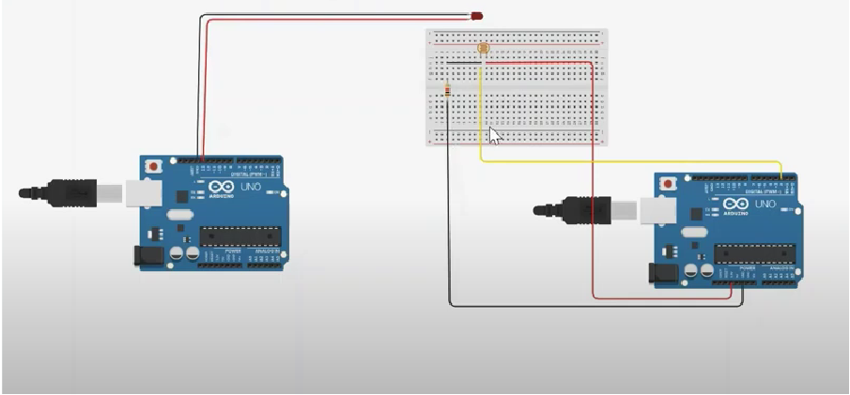
Proposed Methodology with Architecture

Slide 7
METHODOLOGYAND IMPLEMENTATION
One of the most common methods of code communication is Morse code. This work is carried out in three steps,
1: Firstly the message is encrypted to morse code. The encrypted morse code should be made visible to the target. For this purpose a flash light is used. This flashlight should blink according to the encrypted morse code.
2: To link this flashlight and the encrypted morse code Arduino UNO is used. Arduino UNO toggles the flashlight according to the user input.
3:Flash-toggling which is received on the target side gets reconverted into morse code and then decrypted into text is done successfully.
The code for encryption and decryption is compiled successfully in Terminal.

Slide 8
It worked by transmitting electrical signals over a wire laid between stations.
In addition to helping invent the telegraph, the Morse code assigned a set of dots and dashes to each letter of the English alphabet and allowed for the simple transmission of complex messages across telegraph lines.
Conclusion

